Slide 1


Analyzing the Analyzers: FlowDroid/IccTA, AmanDroid, DroidSafe
Lina Qiu, Yingying Wang, Julia Rubin
{lqiu, wyingying, mjulia}@ece.ubc.ca
The Reliable, Secure, and Sustainable Software Lab (ReSeSS)
Department of Electrical and Computer Engineering

Slide 2

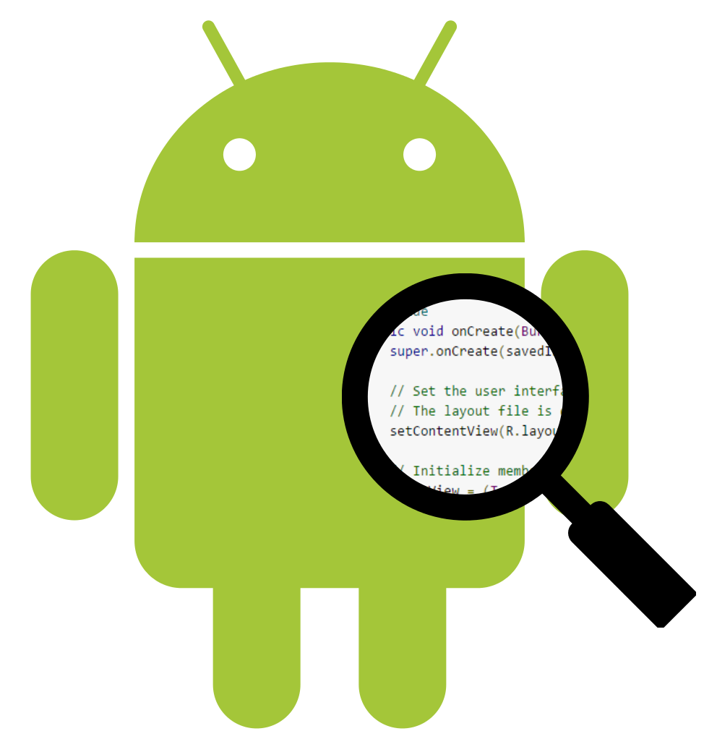







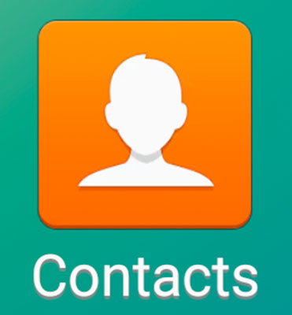
Static Taint Analysis for Android Applications
App
Sensitive sources
Sensitive sinks
Leak!

Slide 3
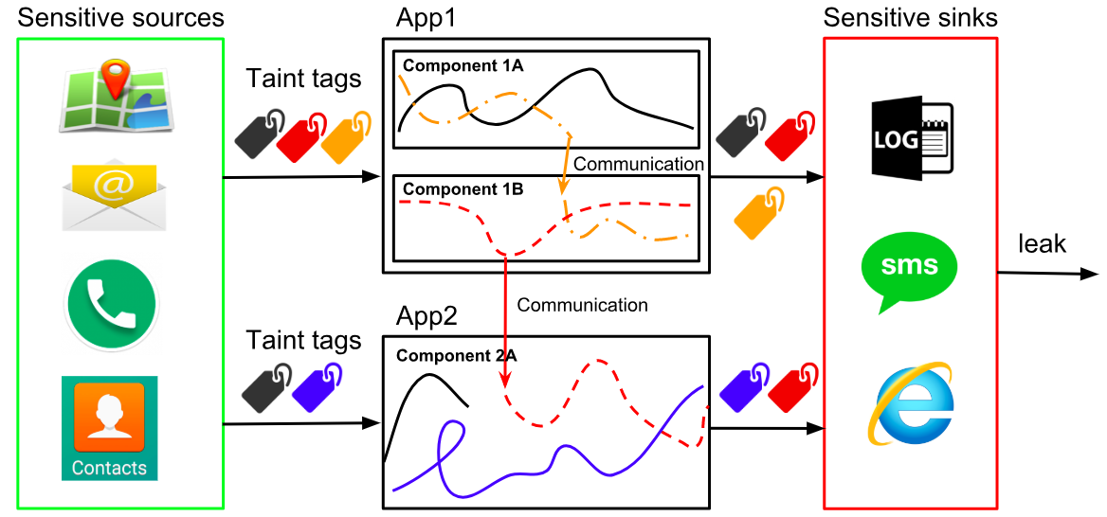
Static Taint Analysis for Android Is Difficult
Android modeling
Application lifecycle
Inter-component communication

Slide 4

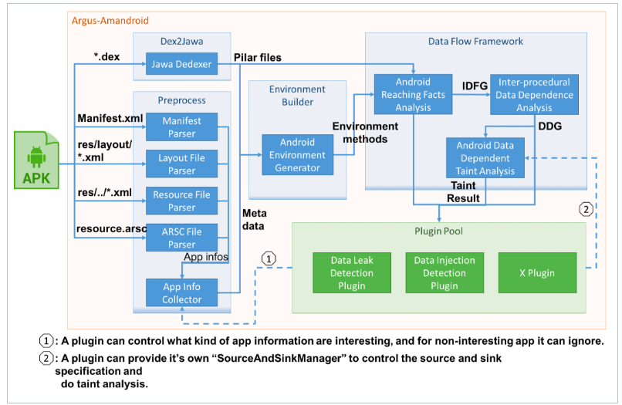

Most Known Static Taint Analysis Tools for Android
AmanDroid
DroidSafe
FlowDroid+IccTA
[FlowDroid v2.x]
FlowDroid+IccTA: https://github.com/secure-software-engineering/soot-infoflow-android/tree/FlowDroid_2.0
AmanDroid: https://bintray.com/arguslab/maven/argus-saf/3.1.1
DroidSafe: https://github.com/MIT-PAC/droidsafe-src

Slide 5
Existing Results, Who is Right?
97%
63%
FlowDroid+
IccTA
AmanDroid
85%
96%
48%
98%
93%
96%
98%
76%
91%
90%
100%
5%
Results are taken from existing work and reported in terms of F-measure

Slide 6

How Is That Possible?

Slide 7
Tools Are Often Evaluated ...
under different configuration parameters
against a selected set of benchmarks
with different sets of sources and sinks

Slide 8

Compare Tools under Common Setup

Slide 9
Not a Trivial Task Because…
Not all design decisions are documented
Ran experiments to extract undocumented design decisions, e.g., field sensitivity for DroidSafe
Some configuration options are not tunable
Non-tunable and not supported by a tool, e.g., implicit flow for AmanDroid → disable in all tools
Non-tunable and supported by a tool, e.g., ICC for AmanDroid and DroidSafe → enable in all tools

Slide 10
Configurations Used in Our Analyses
Configuration |  | Selection
Sensitivity | field | √
 | context * | √
 | object | √
 | flow | √
 | path | x
Implicit flows |  | x
Reflection |  | √
Exception |  | √
ICC |  | √
IAC |  | x
UI elements detection |  | x
* DroidSafe is only context-sensitive for static methods

Slide 11

Analyzed a Collective Set of Benchmarks From…
DroidBench: https://github.com/secure-software-engineering /DroidBench/tree/DroidBench_2.0/eclipse-project
ICC-Bench: https://github.com/fgwei/ICC-Bench/tree/v2.0

Slide 12
Extracted Sources and Sinks
 | Signature
Sources | android.telephony.TelephonyManager: java.lang.String getDeviceId()
 | android.telephony.TelephonyManager: java.lang.String getSimSerialNumber()
 | android.location.Location: double getLatitude()
 | android.location.Location: double getLongitude()
 | android.telephony.TelephonyManager: java.lang.String getSubscriberId()
Sinks | android.telephony.SmsManager: void sendTextMessage(java.lang.String,java.lang.String,java.lang.String, android.app.PendingIntent,android.app.PendingIntent)
 | android.util.Log: int i(java.lang.String,java.lang.String)
 | android.util.Log: int e(java.lang.String,java.lang.String)
 | android.util.Log: int v(java.lang.String,java.lang.String)
 | android.util.Log: int d(java.lang.String,java.lang.String)
 | java.lang.ProcessBuilder: java.lang.Process start()
 | android.app.Activity: void startActivityForResult(android.content.Intent,int)
 | android.app.Activity: void setResult(int,android.content.Intent)
 | android.app.Activity: void startActivity(android.content.Intent)
 | java.net.URL: java.net.URLConnection openConnection()
 | android.content.ContextWrapper: void sendBroadcast(android.content.Intent)
Unified set → manually re-evaluated ground truth for each benchmark

Slide 13
Summary: Our Methodology
Ran experiments to extract design decisions
Selected a unified list of sources and sinks
Manually analyzed benchmarks to extract ground truth
Cross-validation by two authors of the paper
Manually analyzed reported flows and identified failures (FPs/FNs)
Cross-validation by two authors of the paper
Contact tool authors when needed

Slide 14
Insight #1: Cannot Reproduce Results in Previous Studies
Tool | F-measure (%) (Ours) | F-measure (%) IccTA [2] | F-measure (%) AmanDroid [3] | F-measure (%) DroidSafe [4]
FlowDroid+IccTA | 85 | 97 | 85 | 76
AmanDroid | 68 | 63 | 96 | -
DroidSafe | 80 | - | 90 | 91
FlowDroid+IccTA | 87 | - | 93 | -
AmanDroid | 92 | - | 98 | -
DroidSafe | - | - | 5 | -
Droid Bench
ICC Bench
Selected benchmarks:
Ours: DroidBench v2.0 (109 apps) and ICC-Bench v2.0 (24 apps).
Li et al.: DroidBench (22 apps developed by IccTA’s authors) and ICC-Bench (9 apps).
Wei et al.: DroidBench (18 apps, about ICC) and ICC-Bench (24 apps).
Gorden et al.: DroidBench (94 apps from v1.2).

Slide 15
Insight #2: Underlying Reasons for Failures (FPs & FNs)
Tool | Distribution of Failures
 | ICC-related | Intra-component-related | Unknown | Total
FlowDroid+IccTA | 8 | 21 | 9 | 38
AmanDroid | 7 | 66 | 4 | 77
DroidSafe | 0 | 41 | 2 | 43
DroidSafe does not run on ICC-Bench, as the benchmarks use Android SDK 25, which the tool does not support.
Unknown: the tool crashed on the benchmark with an exception or we were unable to recover the reason for the failure.

Slide 16
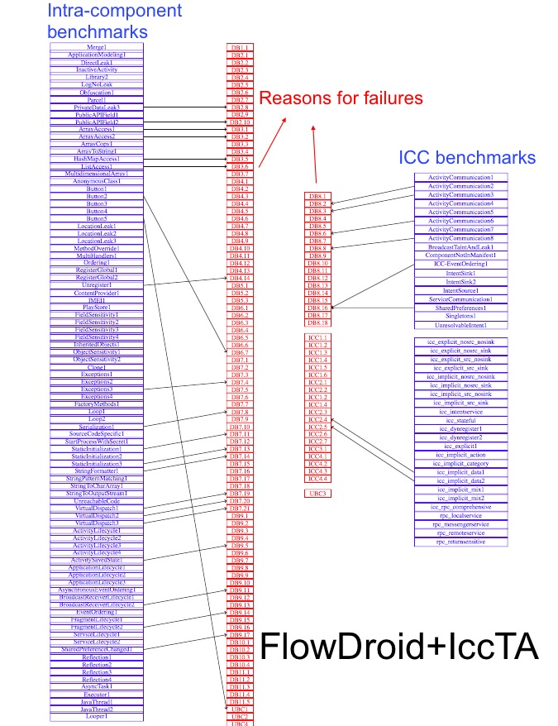
Benchmarks vs. Reasons for Failures
ArrayAccess1
DB3.1
We number each criteria in the format [Test Suite Name][Category ID][SubID of application inside this category].

Slide 17
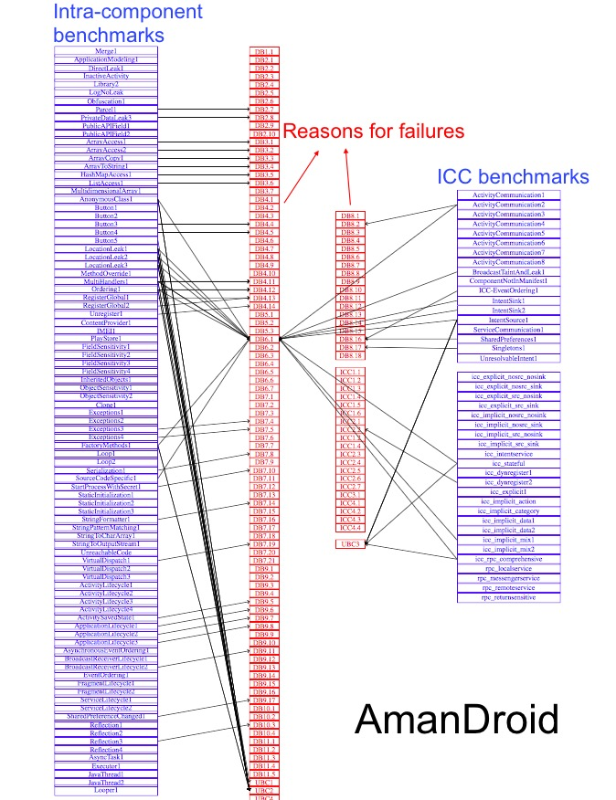
Benchmarks vs. Reasons for Failures
DB6.1
UBC3
UBC2
We number each criteria in the format [Test Suite Name][Category ID][SubID of application inside this category].

Slide 18
Benchmarks vs. Reasons for Failures
DB6.1
UBC3
…
LocationLeak1
LocationLeak2
LocationLeak3
..
Ordering1
…
UBC2
We number each criteria in the format [Test Suite Name][Category ID][SubID of application inside this category].

Slide 19
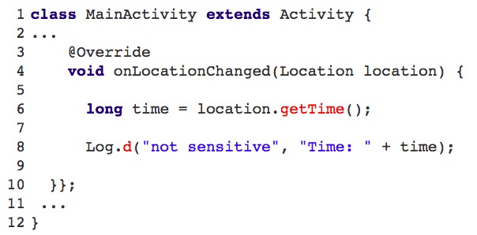
Benchmarks vs. Reasons for Failures
AmanDroid: Overestimates location-related flows (20 failures)
Hard-codes the Location objects as sources
Hard-coded source
DB6.1
UBC3
…
LocationLeak1
LocationLeak2
FP Leak!
LocationLeak3
..
Ordering1
…
UBC2
We number each criteria in the format [Test Suite Name][Category ID][SubID of application inside this category].

Slide 20
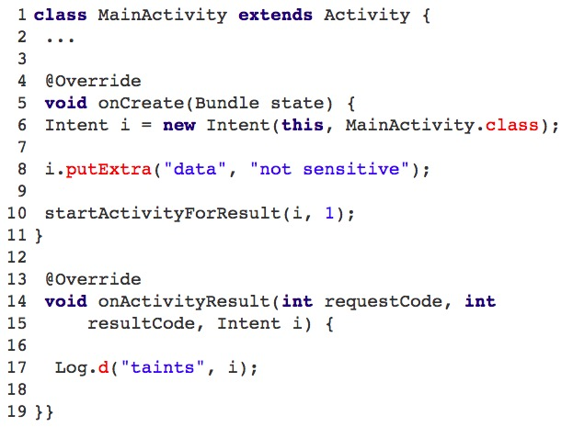
AmanDroid: Overestimates ICC-related flows (5 failures)
Hard-codes the Intent parameters of callbacks as sources
DB6.1
IntentSource1
icc_stateful
UBC3
Hard-coded source
icc_rpc_comprehensive
UBC2
FP Leak!

Slide 21
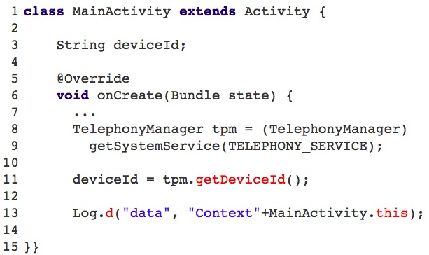
AmanDroid: Misses complex field sensitivity cases (17 failures)
…
Taints all Activity1 fields
…
LocationLeak3
Intent_sink1
MultiHandlers1
DB6.1
Intent_sink2
Ordering1
icc_stateful
FactoryMethods1
icc_implicit_mix1
…
…
UBC3
FP Leak!
UBC2

Slide 22
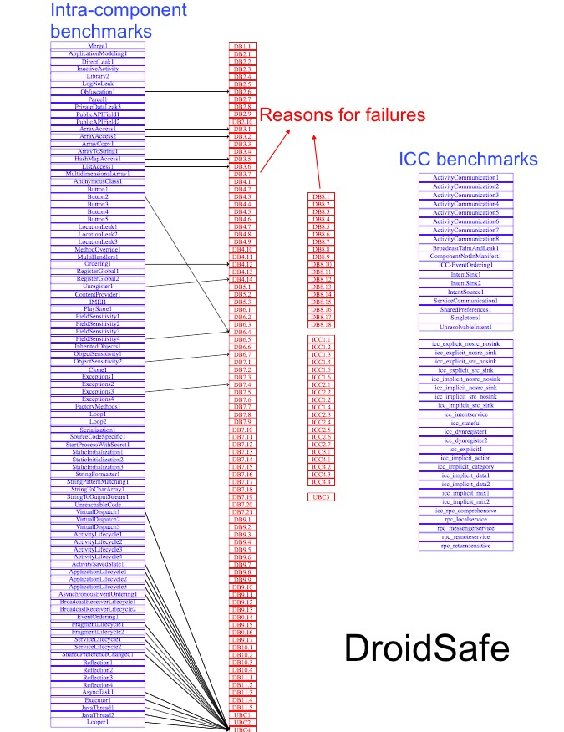

Benchmarks vs. Reasons for Failures
…
VirtualDispatch1
AsyncTask1
...
JavaThread1
JavaThread2
UBC4
…
We number each criteria in the format [Test Suite Name][Category ID][SubID of application inside this category].

Slide 23
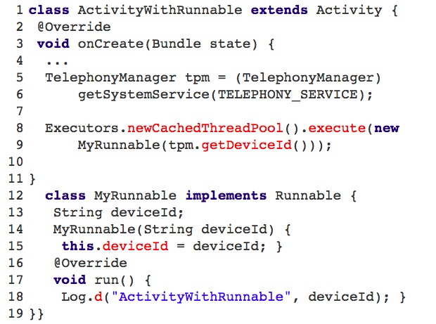
DroidSafe: Fails to handle entry points (29 failures)
Reports incorrect entry method, i.e., the method in which the flow source is defined for the identified flows
Entry Method
…
VirtualDispatch1
AsyncTask1
...
Source
JavaThread1
JavaThread2
UBC4
…
We number each criteria in the format [Test Suite Name][Category ID][SubID of application inside this category].

Slide 24

Real-world Applications
Miss-checked failures by existing benchmarks:
Mathematical operations (+, -, /, x, etc.)
Double tagging (s1, s1.s2 are sources)
Branching (if / else)
Future work:
More thorough analyses on real-world applications
Extend existing benchmarks

Slide 25
Lessons Learned
We need a better way to evaluate tool accuracy
Many failures are due to the same underlying reason
Benchmarks need to be separated into smaller units
Tools fail on a benchmark for multiple reasons, not necessary what the benchmark was designed for
Reporting on experimental setup is extremely important
Configurations, sources and sinks, exact benchmarks, etc.
Running tools on real-world applications is necessary
Existing benchmarks do not cover all “interesting” situations anymore

Slide 26
Related Work
Li et al., Static Analysis of Android Apps: A Systematic Literature Review
Did not run the tools
Qualitative results
Reaves et al., *droid: Assessment and Evaluation of Android Application Analysis Tools
Ran the tools with default configurations
Usability and accessibility of the tools, understandability of the results
Pauck et al., Do Android Taint Analysis Tools Keep their Promises?

Slide 27
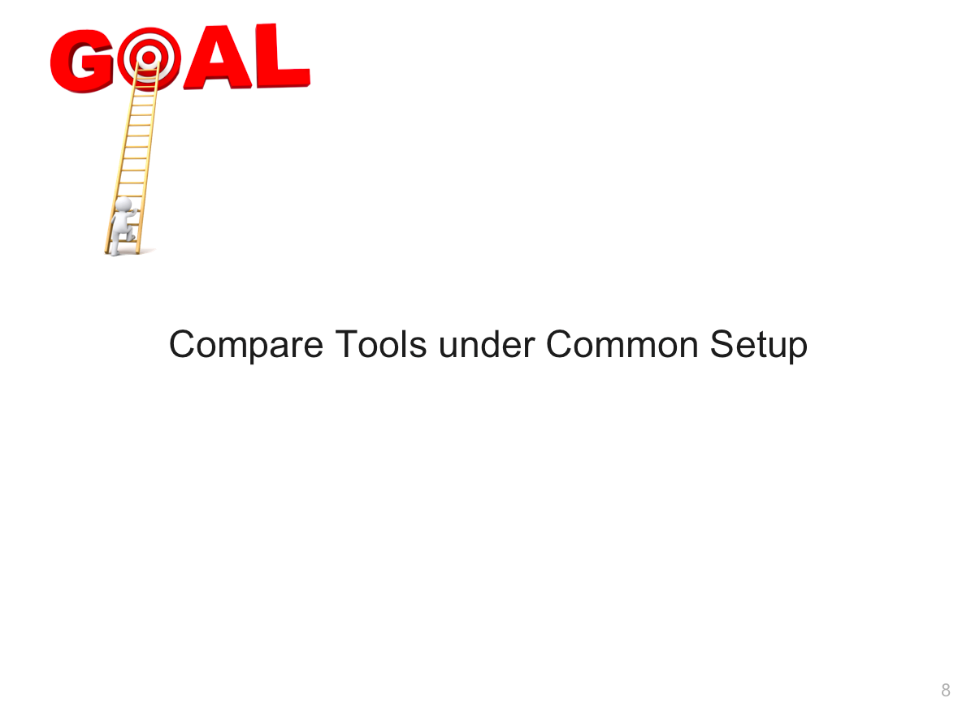
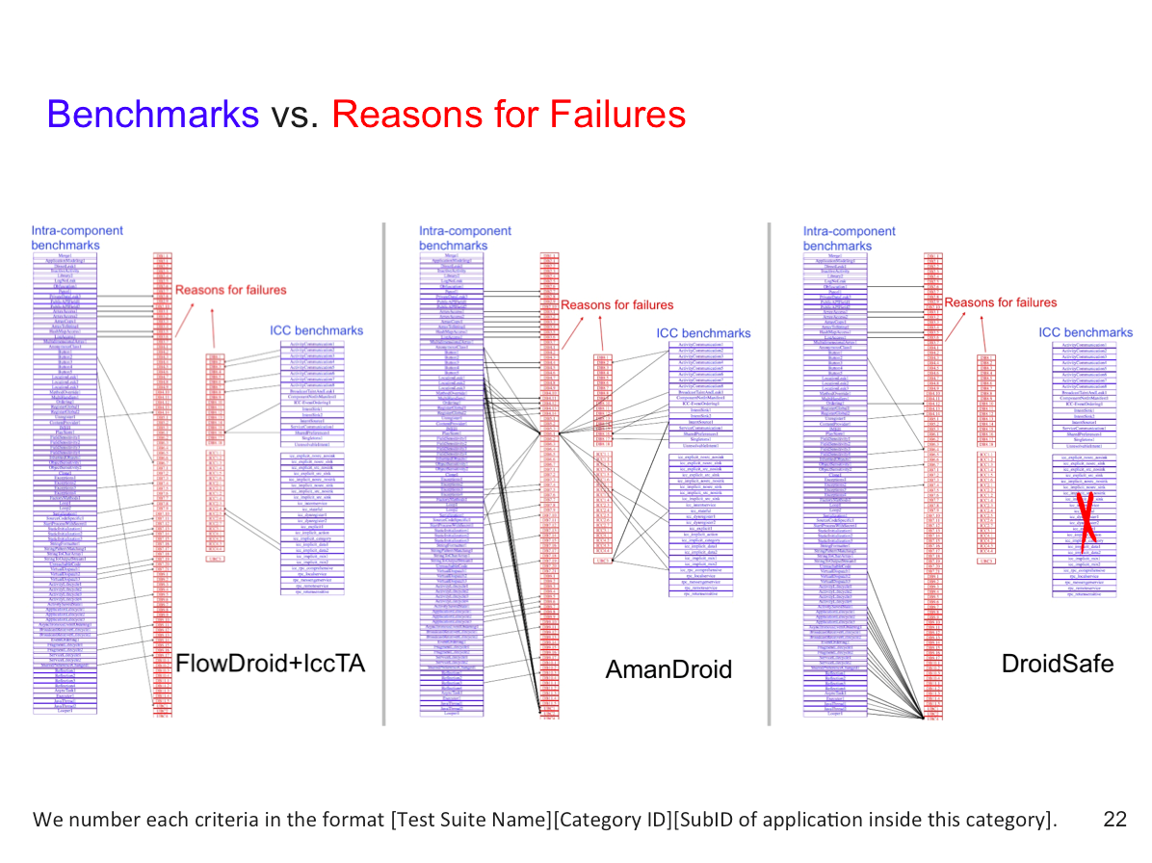
Analyzing the Analyzers: FlowDroid/IccTA, AmanDroid, DroidSafe
Lina Qiu, Yingying Wang, Julia Rubin
{lqiu, wyingying, mjulia}@ece.ubc.ca
The Reliable, Secure, and Sustainable Software Lab (ReSeSS)
Department of Electrical and Computer Engineering

